Slide 1



TOC
lock
Monitor
Spinlock

Slide 2
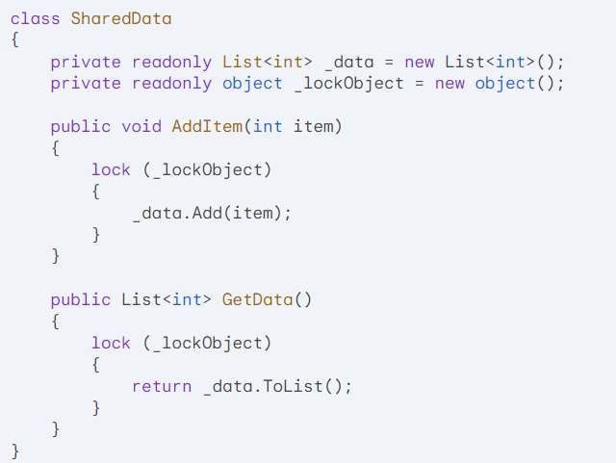

Slide 3
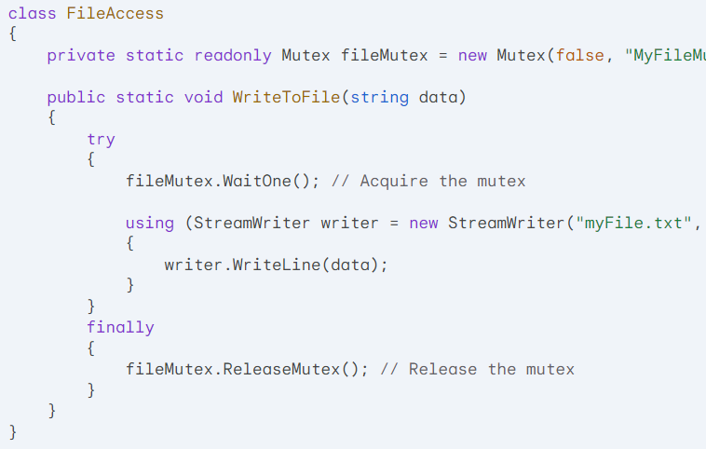

Slide 4
Operating System Locks vs. General Locks
In C#, there are two primary types of locks used for synchronization: operating system locks and general locks.

Slide 5
Operating System Locks:
Mechanism: Implemented at the operating system level, typically using system calls.
Examples: Mutex, Semaphore, EventWaitHandle
Use Cases:
Protecting shared resources across processes.
Coordinating threads or processes that belong to different applications.
Ensuring system-wide synchronization.

Slide 6
General Locks:
Mechanism: Implemented within the .NET framework, using managed code.
Examples: lock keyword, Monitor class
Use Cases:
Protecting shared resources within a single process.
Coordinating threads within the same application.

Slide 7
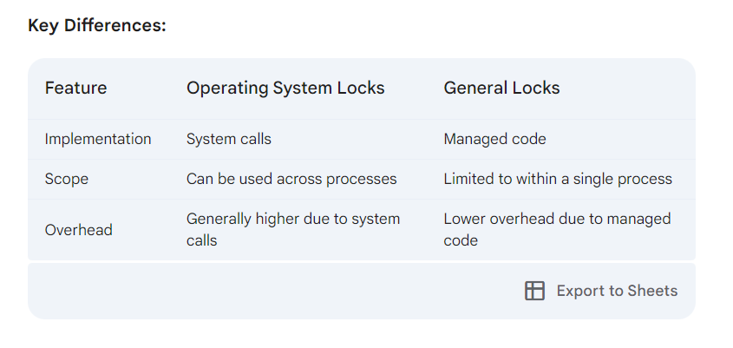

Slide 8
Choosing the Right Lock:
Operating System Locks: Use when you need to synchronize across processes or when you require system-level guarantees.
General Locks: Use for most synchronization scenarios within a single process, as they offer lower overhead and are easier to use.

Slide 9
Real-World Examples:
Operating System Locks:
Protecting shared files or network resources.
Coordinating threads or processes belonging to different applications.
Implementing system-wide synchronization mechanisms.
General Locks:
Protecting shared data structures within a single application.
Coordinating threads within a producer-consumer pattern.
Implementing synchronization mechanisms for asynchronous operations.

Slide 10
Operating System Locks
Mutex:
Ensures exclusive access to a shared resource across processes.
Used for system-level synchronization and protecting shared resources.
Semaphore:
Limits the number of concurrent threads or processes that can access a shared resource.
Used for resource pooling, rate limiting, and controlling concurrency.
EventWaitHandle:
Signals and waits for events between threads or processes.
Used for coordinating asynchronous operations, producer-consumer patterns, and barriers.

Slide 11
General Locks
lock Keyword:
A shorthand for acquiring and releasing a lock on an object.
Used for protecting shared data within a single process.
Monitor Class:
Provides more granular control over synchronization, including waiting and signaling.
Used for coordinating threads, implementing producer-consumer patterns, and protecting shared data.
SpinLock:
A lightweight lock that spins in a loop, avoiding operating system calls.
Suitable for short-lived critical sections with low contention.

Slide 12
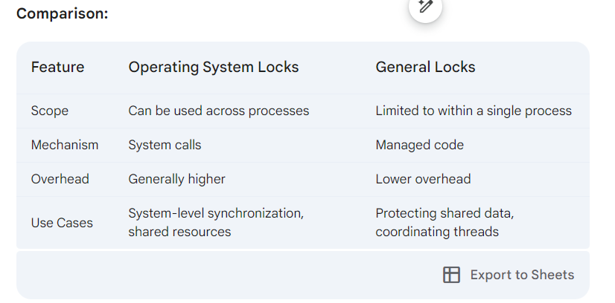

Slide 13
Monitor

Slide 14
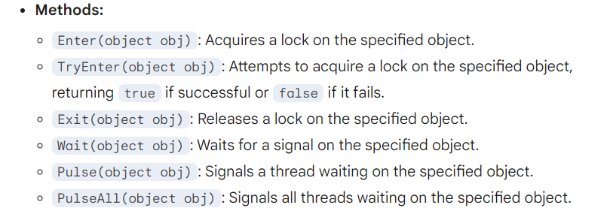
Purpose: A Monitor is a synchronization primitive used to acquire and release locks on shared resources. It provides more granular control over locking than the lock keyword.

Slide 15
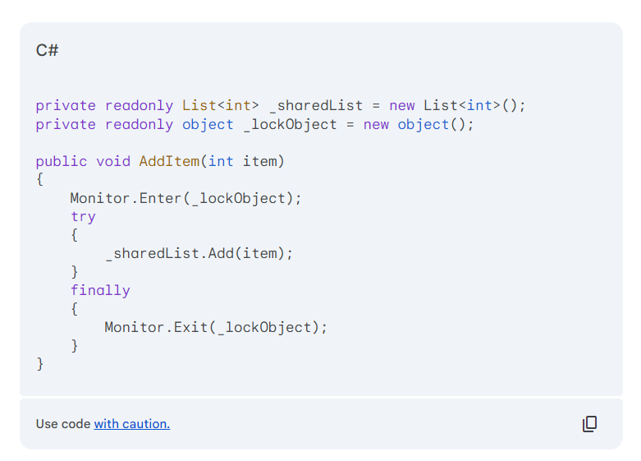
Protecting Shared Data Structures:

Slide 16
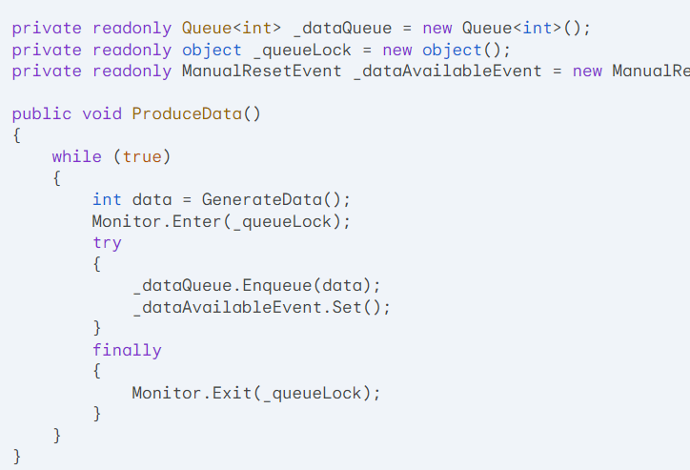
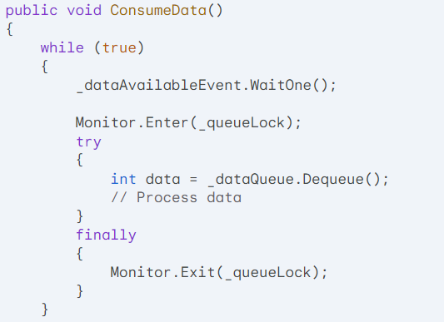
Implementing Producer-Consumer Patterns:

Slide 17
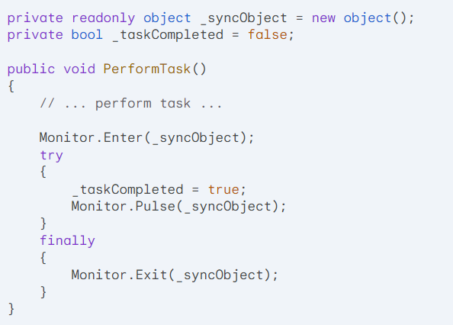
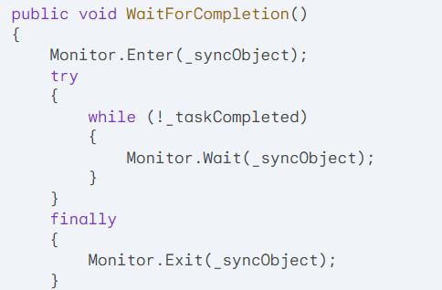
Coordinating Multiple Threads:

Slide 18
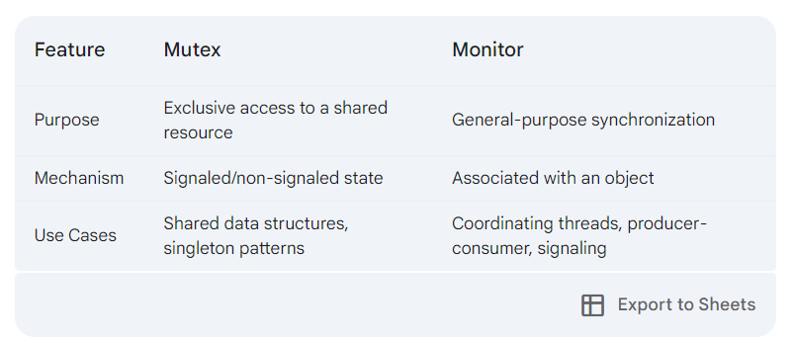

Slide 19
Signaled/Non-Signaled State vs. Associated with an Object
These terms refer to the underlying mechanisms of two different synchronization primitives in C#: Mutex and Monitor.

Slide 20
Signaled/Non-Signaled State:
Used in: AutoResetEvent/Mutex
Meaning: An AutoResetEvent can be in either a signaled or non-signaled state.
Signaled: Indicates that the event has occurred, and a waiting thread can proceed.
Non-signaled: Indicates that the event has not occurred yet, and waiting threads must continue to wait.
Purpose: Used for signaling and waiting for events between threads.

Slide 21
Associated with an Object:
Used in: Monitor
Meaning: A Monitor is associated with a specific object. When a thread acquires a lock on the object, other threads that attempt to acquire the same lock must wait until it's released.
Purpose: Provides a more flexible approach to synchronization, allowing for locking, waiting, and signaling.

Slide 22
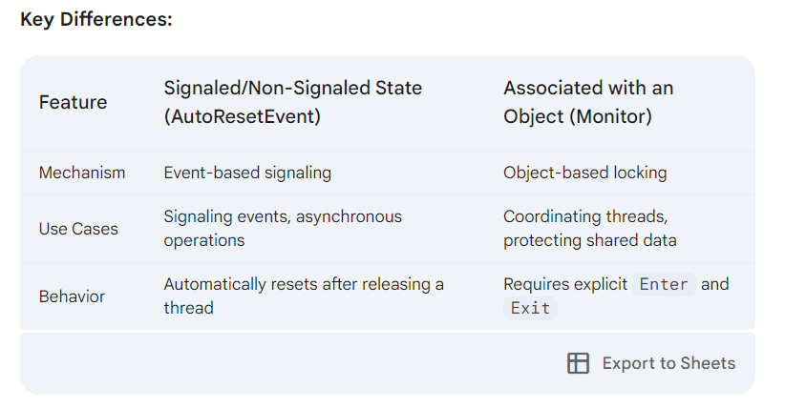

Slide 23
Categorizing Locks in C#
Operating System Locks
Mutex:
Ensures exclusive access to a shared resource across processes.
Used for system-level synchronization and protecting shared resources.
Semaphore:
Limits the number of concurrent threads or processes that can access a shared resource.
Used for resource pooling, rate limiting, and controlling concurrency.
EventWaitHandle:
Signals and waits for events between threads or processes.
Used for coordinating asynchronous operations, producer-consumer patterns, and barriers.

Slide 24
General Locks
lock Keyword:
A shorthand for acquiring and releasing a lock on an object.
Used for protecting shared data within a single process.
Monitor Class:
Provides more granular control over synchronization, including waiting and signaling.
Used for coordinating threads, implementing producer-consumer patterns, and protecting shared data.
SpinLock:
A lightweight lock that spins in a loop, avoiding operating system calls.
Suitable for short-lived critical sections with low contention.

